Slide 1
Hashtables
David Kauchak CS 140 – Spring 2024

Slide 2
Admin
Assignment 5 and 6 back soon
Assignment 7 our and due on Sunday
Normal group session schedule this week

Slide 3
Hashtables
Constant time insertion and search (and deletion in some cases) for a large space of keys
Applications
Does x belong to S?
I’ve found them very useful (go by many names, maps, dictionaries, …)
compilers
databases
search engines
storing and retrieving non-sequential data
save memory over an array

Slide 4
Hashtables
Constant time insertion and search (and deletion in some cases) for a large space of keys
For this class, we’ll just think of them as a collection of keys
For many applications/implementations, there is a value associated with the key, i.e., key/value pair (though lookup is still exclusively based on the key)

Slide 5
Key/data pair
The key is a numeric representation of a relevant portion of the data
For example:
data
key
integer
number

Slide 6
Key/data pair
The key is a numeric representation of a relevant portion of the data
For example:
key?
data
string
number

Slide 7
Key/data pair
The key is a numeric representation of a relevant portion of the data
For example:
data
key
ascii code
string
number

Slide 8
Key/data pair
The key is a numeric representation of a relevant portion of the data
For example:
key?
data
account information
number

Slide 9
Key/data pair
The key is a numeric representation of a relevant portion of the data
For example:
ascii code of first and last name
key
data
account information
number

Slide 10
Why not just arrays, aka direct-address tables?
The array must be as large as the universe of keys
universe of keys - U
Array

Slide 11
Why not just arrays?
The array must be as large as the universe of keys.
universe of keys - U
The space of actual keys is often much smaller than the actual keys.
actual keys, n
Array

Slide 12
Why not arrays?
Think of indexing all last names < 10 characters
Census listing of all last names http://www.census.gov/genealogy/names/dist.all.last
88,799 last names
What is the size of our space of keys?
26¹⁰ = a big number
Not feasible!
Even if it were, not space efficient

Slide 13
The load of a table/hashtable
m = number of possible entries in the table.
n = number of keys stored in the table.
α = n/m is the load factor of the hash table.
What is the load factor of the last example?
α = 88,799 / 26¹⁰ would be the load factor of last names using direct-addressing.
The smaller α, the more wasteful the table.
The load also helps us talk about run time.

Slide 14
Hash function, h
A hash function is a function that maps the universe of keys to the slots in the hash-table.
universe of keys - U
hash function, h: U ➔m
m << |U|

Slide 15
Hash function, h
A hash function is a function that maps the universe of keys to the slots in the hashtable
universe of keys - U
hash function, h: U ➔m
m << |U|

Slide 16
Hash function, h
A hash function is a function that maps the universe of keys to the slots in the hash table.
universe of keys - U
hash function, h: U ➔m
m << |U|

Slide 17
Hash function, h
What can happen if m<|U|?
universe of keys - U
hash function, h: U ➔m
m << |U|

Slide 18
Collisions
If m < |U|, then two keys can map to the same position in the hash table (pigeonhole principle)
universe of keys - U
hash function, h
m << |U|

Slide 19
Collisions
A collision occurs when h(x) = h(y), but x ≠ y
A good hash function will minimize the number of collisions
Because the number of hash table entries is less than the possible keys (i.e., m < |U|) collisions are inevitable!
Collision resolution techniques?

Slide 20
Collision resolution by chaining
Hash table consists of an array of linked lists
When a collision occurs, the element is added to linked list at that location.
If two entries x ≠ y have the same hash value h(x) = h(y), then T(h(x)) will contain a linked list with both values

Slide 21
Insertion
ChainedInsert(x):
entry = h(x)
insert x at the head of T[entry]
ChainedHashInsert( )

Slide 22
Insertion
ChainedInsert(x):
entry = h(x)
insert x at the head of T[entry]
h( )
hash function is a mapping from the key to some value < m

Slide 23
Insertion
ChainedInsert(x):
entry = h(x)
insert x at the head of T[entry]
h( )

Slide 24
Deletion
ChainedDelete(x):
entry = h(x)
delete x at the list at T[entry]
What does that involve?

Slide 25
Deletion
ChainedDelete(x):
entry = h(x)
delete x at the list at T[entry]
Search though the list!

Slide 26
Deletion
ChainedDelete(x):
entry = h(x)
delete x at the list at T[entry]
ChainedHashDelete( )

Slide 27
Deletion
ChainedDelete(x):
entry = h(x)
delete x at the list at T[entry]
h( )

Slide 28
Deletion
ChainedDelete(x):
entry = h(x)
delete x at the list at T[entry]

Slide 29
Deletion
ChainedDelete(x):
entry = h(x)
delete x at the list at T[entry]

Slide 30
Deletion
ChainedDelete(x):
entry = h(x)
delete x at the list at T[entry]

Slide 31
Search
ChainedSearch(x):
entry = h(x)
search for x in list T[entry]
ChainedHashSearch( )

Slide 32
Search
ChainedSearch(x):
entry = h(x)
search for x in list T[entry]
h( )

Slide 33
Search
ChainedSearch(x):
entry = h(x)
search for x in list T[entry]
ChainedHashSearch( )

Slide 34
Search
ChainedSearch(x):
entry = h(x)
search for x in list T[entry]
ChainedHashSearch( )

Slide 35
Search
ChainedSearch(x):
entry = h(x)
search for x in list T[entry]
ChainedHashSearch( )

Slide 36
Running time
ChainedInsert(x):
entry = h(x)
insert x at the head of T[entry]
Θ(1)
ChainedDelete(x):
entry = h(x)
delete x at the list at T[entry]
O(length of the chain)
ChainedSearch(x):
entry = h(x)
search for x in list T[entry]
O(length of the chain)

Slide 37
Length of the chain
Worst case?

Slide 38
Length of the chain
Worst case?
All elements hash to the same location
h(k) = 4
n
…

Slide 39
Length of the chain
Average case:
Depends on how well the hash function distributes the keys.
What is the best we could hope for a hash function?
simple uniform hashing: an element is equally likely to end up in any of the m slots.
Under simple uniform hashing what is the average length of a chain in the table?
n keys over m slots = n / m = α

Slide 40
Average chain length
If you roll a fair m sided die n times, how many times are we likely to see a given value?
For example, 10-sided die:
1 time
1/10
100 times
100/10 = 10

Slide 41
Search average running time
Two cases:
Key is not in the table
must search all entries
Θ(1 + α)
Key is in the table
on average search half of the entries
O(1 + α)

Slide 42
Hash functions
What makes a good hash function?
Approximates the assumption of simple uniform hashing
Deterministic – h(x) should always return the same value
Low cost – if it is expensive to calculate the hash value (e.g., log n) then we don’t gain anything by using a table
Challenge: we don’t generally know the distribution of the keys.
Frequently data tend to be clustered (e.g., similar strings, run-times, SSNs). A good hash function should spread these out across the table.

Slide 43
Hash functions
What are some hash functions you’ve heard of before?

Slide 44
Division method
h(k) = k mod m
m k h(k)
11 25
11 1
11 17
13 133
13 7
13 25

Slide 45
Division method
h(k) = k mod m
m k h(k)
11 25
3
11 1
1
11 17
6
13 133
3
13 7
7
13 25
12

Slide 46
Division method
Don’t use a power of two. Why?
m k bin(k) h(k)
25 11001
8 1 00001
8 17 10001

Slide 47
Division method
Don’t use a power of two. Why?
if h(k) = k mod 2^{p}, the hash function is just the lower p bits of the value
m k bin(k) h(k)
25 11001 1
8 1 00001 1
8 17 10001 1

Slide 48
Division method
Good rule of thumb for m is a prime number not too close to a power of 2
Pros:
quick to calculate
easy to understand
Cons:
keys close to each other will end up close in the hash table.

Slide 49
Multiplication method
Multiply the key by a constant 0 < A < 1 and extract the fractional part of kA, then scale by m to get the index
extracts the fractional portion of kA

Slide 50
Multiplication method
Common choice is for m as a power of 2 and
Why a power of 2?
Book has other heuristics

Slide 51
Multiplication method
Common choice is for m as a power of 2 and
Book has other heuristics

Slide 52
Multiplication method
m k A
8 15 0.618
8 23 0.618
8 100 0.618
kA h(k)

Slide 53
Multiplication method
m k A
8 15 0.618
8 23 0.618
8 100 0.618
kA h(k)
9.27
floor(0.27*8) = 2
14.214
floor(0.214*8) = 1
61.8
floor(0.8*8) = 6

Slide 54
Other hash functions
http://en.wikipedia.org/wiki/List_of_hash_functions
cyclic redundancy checks (i.e., disks, cds, dvds)
Checksums (i.e., networking, file transfers)
Cryptographic (i.e., MD5, SHA)

Slide 55
Open addressing
Keeping around an array of linked lists can be inefficient and a hassle
We’d like to keep the hash table as just an array of elements (no pointers).
How do we deal with collisions?
compute another slot in the hash table to examine

Slide 56
Hash functions with open addressing
Hash function must define a probe sequence which is the list of slots to examine when searching or inserting.
The hash function takes an additional parameter i which is the number of collisions that have already occurred.
The probe sequence must be a permutation of every hash table entry. Why?
{ h(k,0), h(k,1), h(k,2), …, h(k, m-1) } is a permutation of { 0, 1, 2, 3, …, m-1 }
Notes:
If we didn’t do this, we wouldn’t visit all of the entries in the table!

Slide 57
Hash functions with open addressing
Hash function must define a probe sequence which is the list of slots to examine when searching or inserting
The hash function takes an additional parameter i which is the number of collisions that have already occurred
The probe sequence must be a permutation of every hash table entry. Why?
If not, we wouldn’t explore all the possible location in the table!
Notes:
If we didn’t do this, we wouldn’t visit all the entries in the table!

Slide 58
Probe sequence
h(k, 0)

Slide 59
Probe sequence
h(k, 1)

Slide 60
Probe sequence
h(k, 2)

Slide 61
Probe sequence
h(k, 3)

Slide 62
Probe sequence
h(k, …)
must visit all locations
…

Slide 63
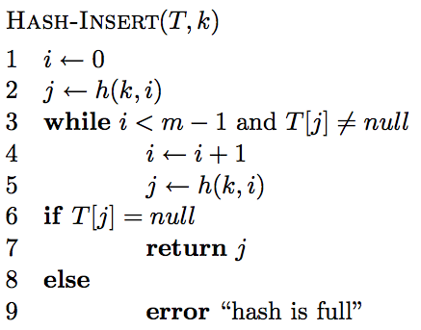
Open addressing: Insert

Slide 64
Open addressing: Insert
get the first hash table entry to look in

Slide 65
Open addressing: Insert
follow the probe sequence until we find an open entry

Slide 66
Open addressing: Insert
return the open entry

Slide 67
Open addressing: Insert
Hash table can fill up

Slide 68
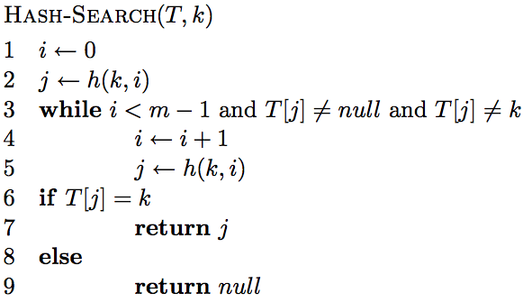
Open addressing: search

Slide 69
Open addressing: search

Slide 70
Open addressing: search
“breaks” the probe sequence

Slide 71
Delete
k
h(k, 0)
h(k, 2)
h(k, 1)

Slide 72
Delete
Can we just delete this node?
k
h(k, 0)
h(k, 2)
h(k, 1)

Slide 73
Delete
Can we just delete this node?
k
h(k, 0)
h(k, 2)

Slide 74
Delete
Can we just delete this node?
No! Now if we search for k we’ll mistakenly think it’s not there!
k
h(k, 0)
h(k, 2)
h(k, 1)

Slide 75
Open addressing: delete
Two options:
mark node as “deleted” (rather than null)
modify search procedure to continue looking if a “deleted” node is seen
modify insert procedure to fill in “deleted” entries
increases search times
if a lot of deleting will happen, use chaining

Slide 76
Probing schemes
Linear probing – if a collision occurs, go to the next slot
h(k,i) = (h(k) + i) mod m
Does it meet our requirement that it visits every slot?
for example, m = 7 and h(k) = 4
h(k,0) = 4
h(k,1) = 5
h(k,2) = 6
h(k,3) = 0
h(k,3) = 1

Slide 77
Linear probing: search
h( , 0)

Slide 78
Linear probing: search
h( , 1)

Slide 79
Linear probing: search
h( , 2)

Slide 80
Linear probing: search
h( , 3)

Slide 81
Linear probing: search
h( , 3)

Slide 82
Linear probing
Problem:
primary clustering – long runs of occupied slots tend to build up and these tend to grow
any value here results in an increase in the cluster
become more and more probable for a value to end up in that range

Slide 83
Quadratic probing
h(k,i) = (h(k) + c₁i + c₂i²) mod m
Rather than a linear sequence, we probe based on a quadratic function
Problems:
must pick constants and m so that we have a proper probe sequence
if h(x) = h(y), then h(x,i) = h(y,i) for all i
secondary clustering

Slide 84
Double hashing
Probe sequence is determined by a second hash function
h(k,i) = (h₁(k) + i(h₂(k))) mod m
Problem:
h₂(k) must visit all possible positions in the table

Slide 85
Running time of insert and search for open addressing
Depends on the hash function/probe sequence
Worst case?
O(n) – probe sequence visits every full entry first before finding an empty

Slide 86
Running time of insert and search for open addressing
Average case?
We must make at least one probe

Slide 87
Running time of insert and search for open addressing
Average case?
What is the probability that the first probe will not be successful (assume uniform hashing function)?
α

Slide 88
Running time of insert and search for open addressing
Average case?
What is the probability that the first two probed slots will not be successful?
~α²
why ‘~’?

Slide 89
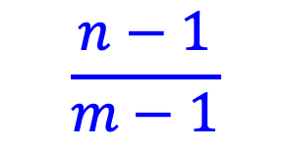
Running time of insert and search for open addressing
Average case?
What is the probability that the first two probed slots will not be successful.
~α²
$$\frac{n−1}{m−1}$$
Technically, second probe is:
Notes:
For largish, n and m, this is close to alpha

Slide 90
Running time of insert and search for open addressing
Average case?
What is the probability that the first three probed slots will not be successful?
~α³

Slide 91
Running time of insert and search for open addressing
Average case: expected number of probes
sum of the probability of making 1 probe, 2 probes, 3 probes, …

Slide 92
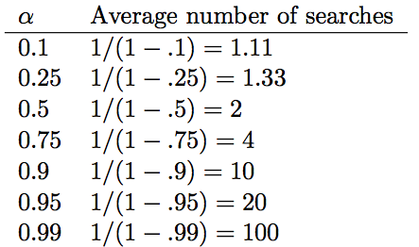
Average number of probes

Slide 93
How big should a hashtable be?
A good rule of thumb is the hash table should be around half full
What happens when the hash table gets full?
Copy: Create a new table and copy the values over
results in one expensive insert
simple to implement
Amortized copy: When a certain ratio is hit, grow the table, but copy the entries over a few at a time with every insert
no single insert is expensive and can guarantee per insert performance
more complicated to implement

Slide 94
Handouts/exercises

Slide 95
Questions
Why can’t we just use an array?
What is a hash function? How does it differ from the hash_code method in Java?
What are the two ways we deal with collisions?
Why is it important that the probe sequence visits every spot in the hashtable?

Slide 96
Questions
What are three potential probing mechanisms?
If we insert random data into a hashtable, what is the worst case running time for searching for an item?
If an open-addressed hashtable is half full, on average, how many entries would we expect to search before finding an open one? 75% full?
If we plan to do a lot of deleting, what type of hashtable should we use?

Slide 97
Questions
What is the largest α can be for a hashtable with chaining? Open-addressed?

Slide 98
Fill in the table for division method
h(k) = k mod m
m k h(k)
11 25
11 1
11 17
13 133
13 7
13 25

Slide 99
Fill in the table for multiplication method
m k A
8 15 0.618
8 23 0.618
8 100 0.618
kA h(k)

